Slide 1
Influences and Influencers
of workplace compliance
Ai Group 2018 National Policy-Influence-Reform Conference
Tuesday 1 May 2018

Slide 2
What does the data say?

Slide 3
Campaigns
Compliance rates (compliant with all obligations)
Compliance rate for monetary obligations
Large business compliance rate
Small business compliance rate

Slide 4
HOSPITALITY2016-17
Hospitality workers make up 7.2% of the workforce
They are over-represented in FWO’s dispute forms with 17%
And 39% of
Anonymous tip-offs

Slide 5
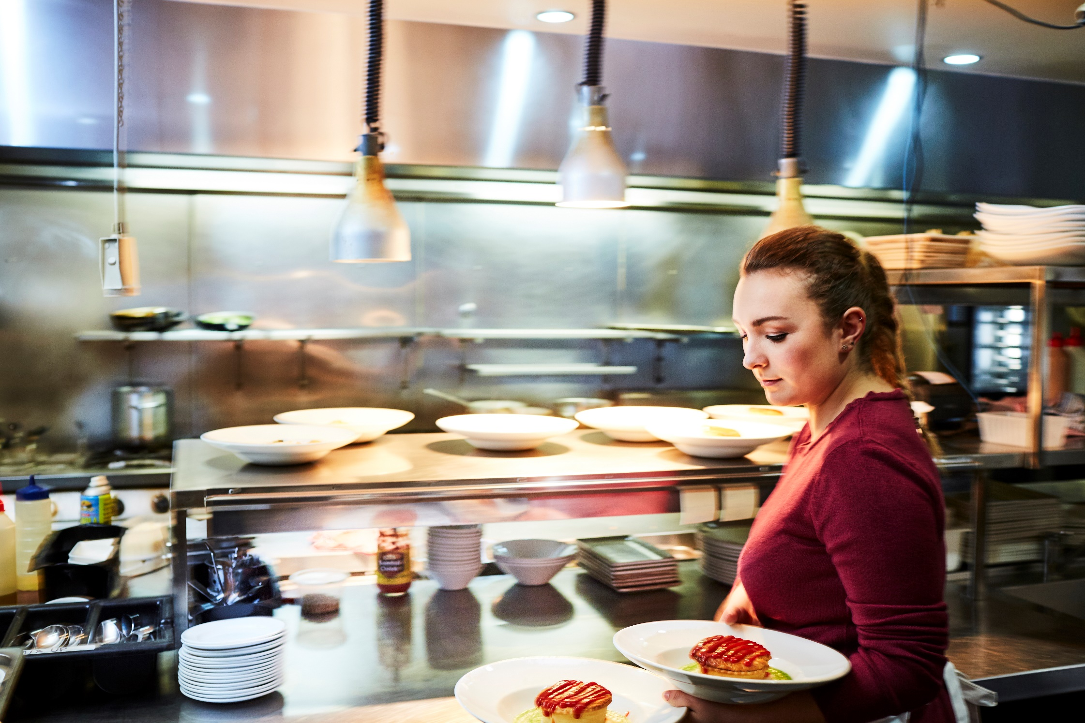
Fast Food Cafes & Restaurants
One in 10 dispute forms in 2016-17
29% of Litigations in 2015-16 and 2016-17

Slide 6
Number of disputes by FY and cohort
All FWO (RH axis)
Trolley collectors
7-Eleven
Baiada
2013
2014
2015
2016
2017
2018
September 2017
Woolworths Ltd PCD
May 2014
UTC PCD
June 2014
Woolworths trolley collection Inquiry commences
October 2014
Coles Supermarkets Australia EU
June 2016
Woolworths trolley collection Inquiry report released

